Slide 1
Verbal and non-verbal communication with native speakers of a foreign language
Institute of Psychology
Department of psychological support of professional activity
СветланаКорзун
Татьяна Нифонтова

Slide 2
VERBAL COMMUNICATION It means communicating with words, written or spoken. Verbal communication consists of speaking, writing reading

Slide 3
Characteristics of effective verbal communication: - consider the objrctive - be sincere - use simple language, familiar words - be brief and precise - assume nothing - use polite words and tone - say something interesting and pleasing

Slide 4
NONVERBAL COMMUNICATION Nonverbal communication includes all unwritten and unspoken messages, both intentional unintentional

Slide 5
Types of non verbal communication Kinesics communication Meta communication - Body language - through words, depicting alternate meaning. - includes behavior - shows latent meaning

Slide 6
Forms of non verbal communication
Facial expression
Gestures
Voise
Body movement
Eye contact
Touch

Slide 7
Features: - non verbal communication flows through all acts of speaking or writing. - they are the wordless messages. - is a creative activity, which comes through stimuli produced by the mind.

Slide 9
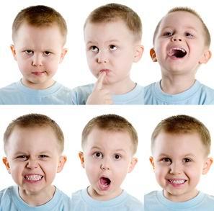

Slide 11
Task:
https://www.youtube.com/watch?v=VBHwcAFXjHc
https://www.youtube.com/watch?v=iuvys5Achb4

