Slide 1
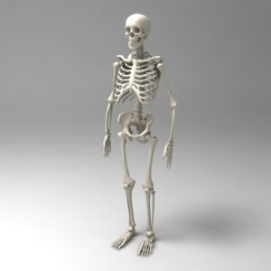
GENERAL OSTEOLOGY
РЕПОЗИТОРИЙ БГПУ

Slide 2
Osteology is the part of anatomy which studies bones. It is quite difficult to determine the exact number of bones, because their number changes with age. The skeleton in an adult person contains only 206 bones. Apart from permanent bones, there may be inconstant (sesamoid) bones in mature age, their appearance is caused by specific features of the body structure and function. The bones, together with their joints, form the skeleton of the human body. It serves as a place for start and attachment of muscles, provides protection of visceral organs and also carries out the formbuilding and some other major functions.
РЕПОЗИТОРИЙ БГПУ

Slide 3
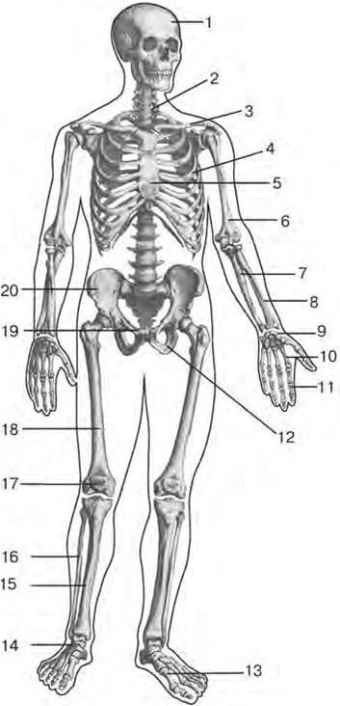
Fig. 1. Human skeleton (frontal aspect): 1 – skull; 2 – vertebral column; 3 – clavicle; 4 – IV rib; 5 – sternum; 6 – humerus; 7 – ulna; 8 – radius; 9 – carpal bones; 10 – metacarpal bones; 11 – phalanges of hand; 12 – ischium; 13 – metatarsal bones; 14 – tarsal bones; 15 – tibia; 16 – fibula; 17 – patella; 18 – femur; 19 – pubis; 20 – ilium.
РЕПОЗИТОРИЙ БГПУ

